Slide 1
Algorithmic Music Generation Through Classification and a Cellular Automata Inspired System
Tom Richmond

Slide 2
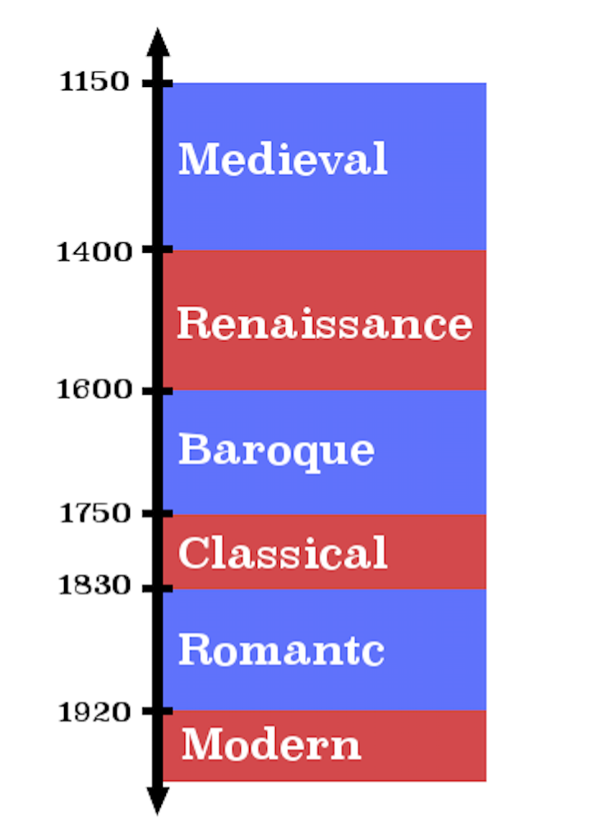
Classical Music
Six distinct eras of Classical music
Each has it’s own defining features, which students of music theory can use to identify aurally and visually

Slide 3
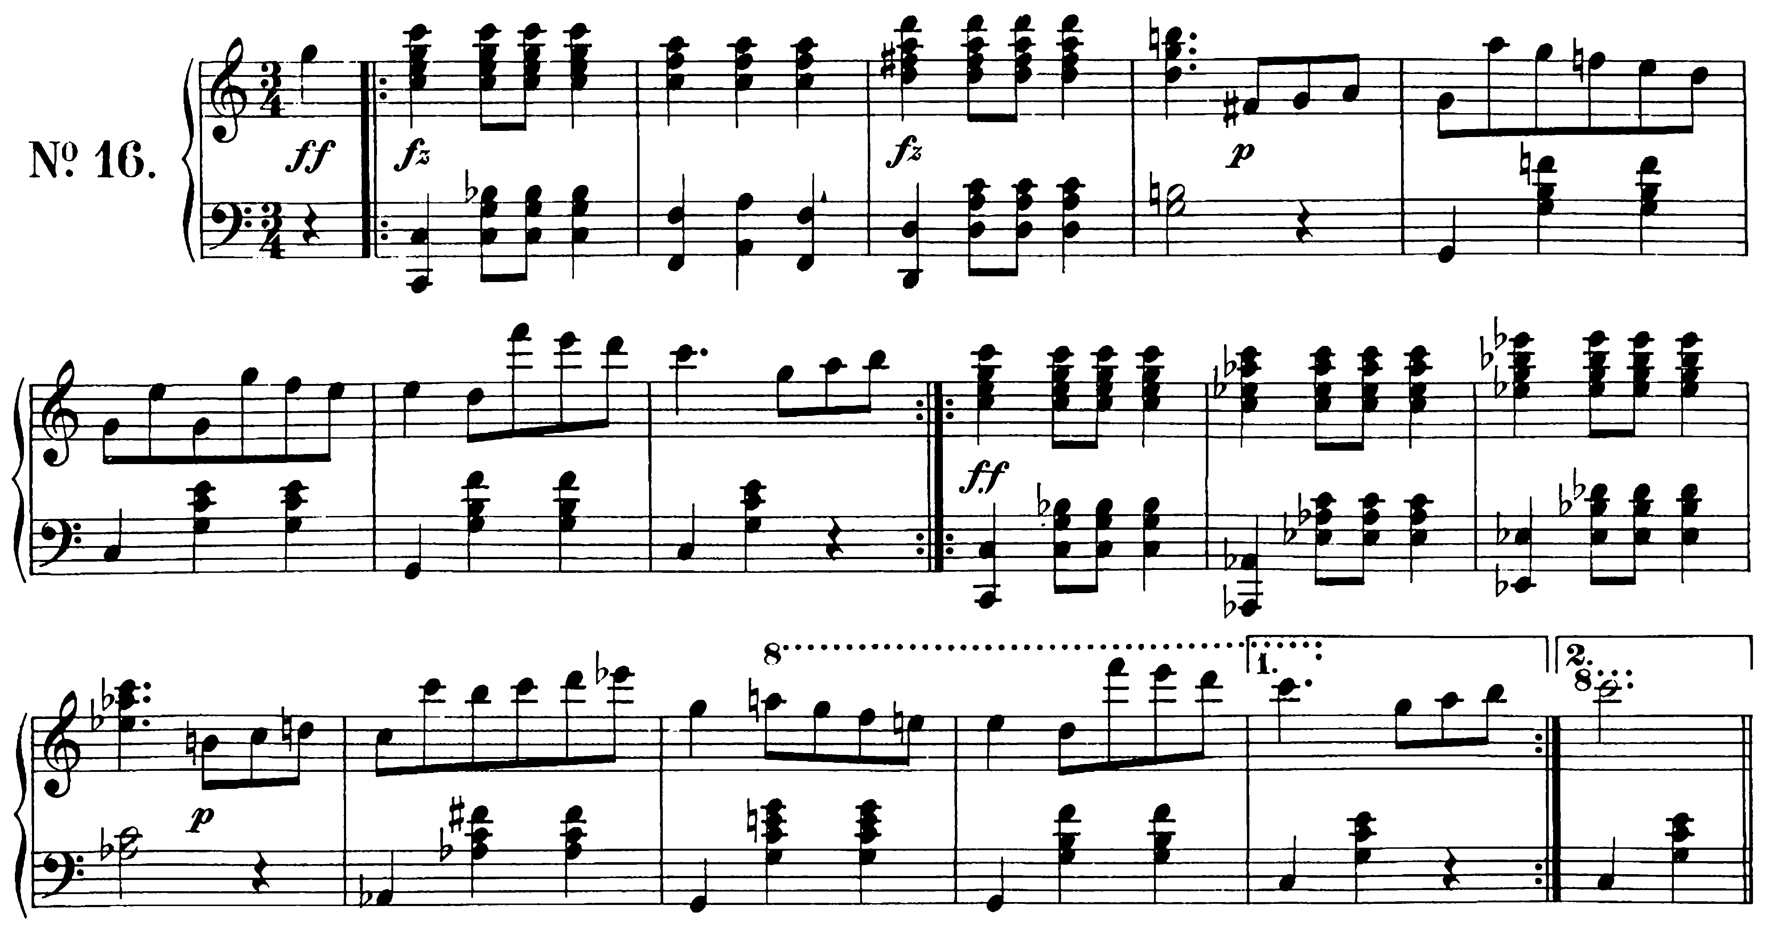
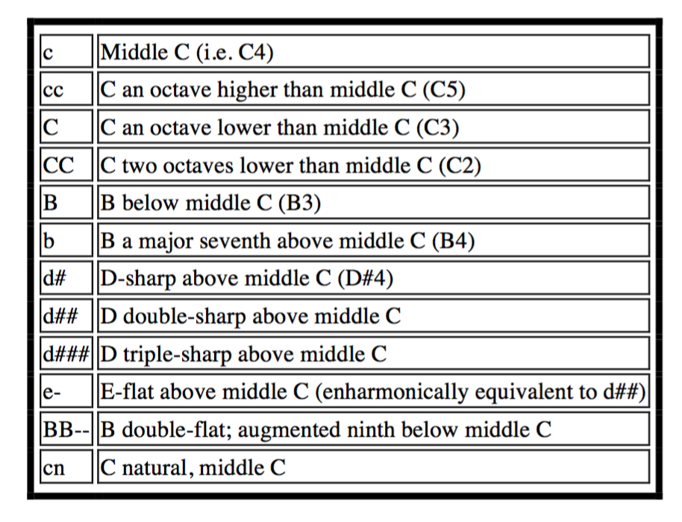
Data Representation
Traditionally represented with a musical score, or sheet music
**kern file format - Text based representation of a musical score
High-level feature format, conforms to Humdrum syntax
Uses spines and precise syntax to represent a piece

Slide 4
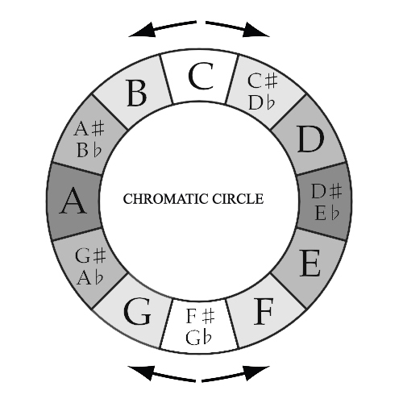
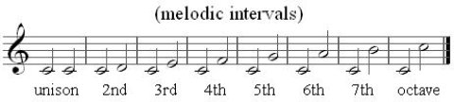
Brief Music Lesson
In western music, there are 12 note values in a cyclical order, going from C to B
The distance between two consecutive notes is known as a melodic interval

Slide 5
Classification
Classification is a data mining function that assigns items in a collection to target categories or classes.
The goal of classification is to accurately predict the target class for each case in the data.
This is done by training the classifier with a ‘training set’ of already categorized data, then testing its accuracy with a ‘test set’

Slide 6

Classification
Weka makes classification a breeze, open source available
Each classifier requires a data set with a finite number of identified attributes, as well as a class distinction (i.e. Musical Eras)
Preferred numerical attributes (20) for ease of use in generation process
Features extracted include frequencies of interval and note occurrences

Slide 7
Feature Extraction
Humdrum Toolkit for Linux Command Line
Features appended to an arff (Attribute-Relation File Format) file through series of piping commands in a “do-for” loop
Some commands used (selected from over 70 tools):
egrep – find pattern occurrences within *kern file
wc – used in conjunction of egrep –o option
mint – translates *kern file to represent the melodic intervals in piece

Slide 8
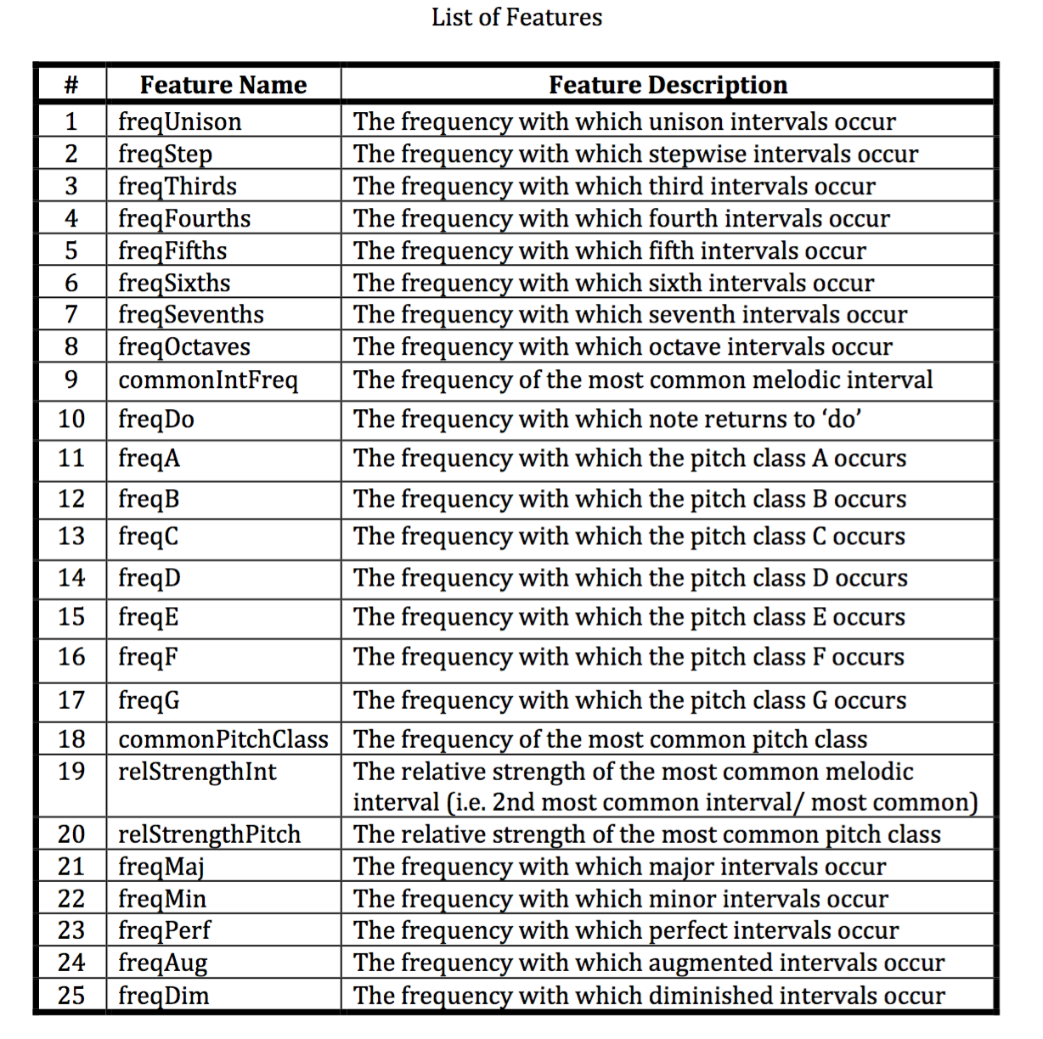

Slide 9
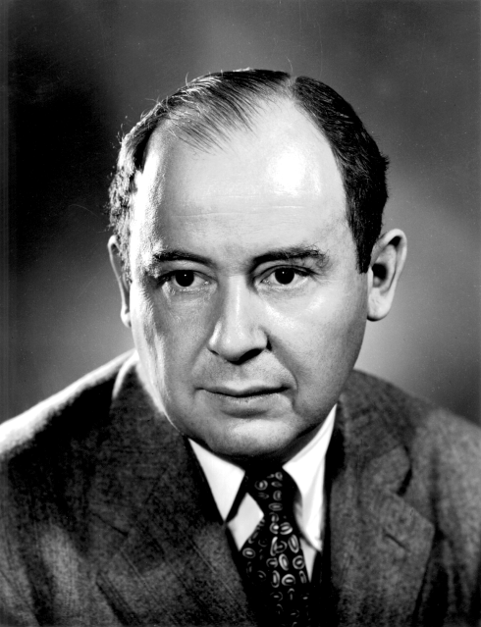
Cellular Automata Overview
Cellular Automata (singular: Automaton) is a structural system that attempts to mimic the cellular replication process
First proposed as a system by John von Neumann in the 60’s
Each cell has one of a finite number of states. New states determined by state of neighbors
1D and 2D Automata are most common

Slide 10
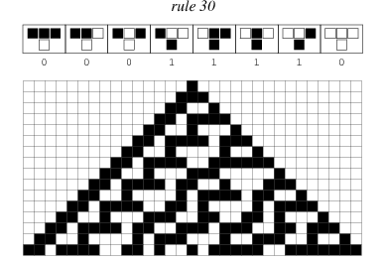
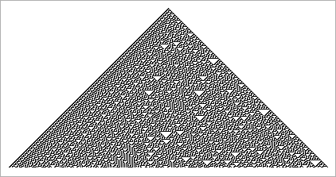
1D Cellular Automata
Most famous 1D Cellular Automata: the Wolfram Elementary Algorithm
Based on selected rule, bottom row will evolve relative to only the previous row
Using this basic principle, it is possible to create binary representations using the bottom row of cells with 1 and 0 states

Slide 11
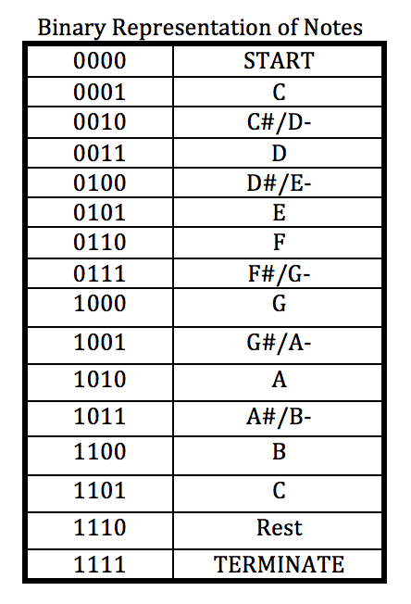
Binary representations
Using binary, it is possible to represent these previously discussed note values in a four byte number, from 0000 – 1111
15 values available, 12 notes, a rest, as well as START and TERMINATE values

Slide 12
Cellular Automata rules
Wolfram algorithm seeks the value of three Automatons above to determine value of new automaton. (111 -> 0)
Modified use of this principle implemented, taking into account the value of all four cells of the previous sequence
This will change the value of the entire new sequence

Slide 13
Rule Generation
Logistic Regression (88.8% ROC) favored for ease of use, and it’s natural use of probability
The rules will be derived using probability relative to results of the classifier
First, the previous sequence will reveal the most recent note
Then, using probability matrix, next interval will be generated, and value will be changed relative to the previous sequence

Slide 14
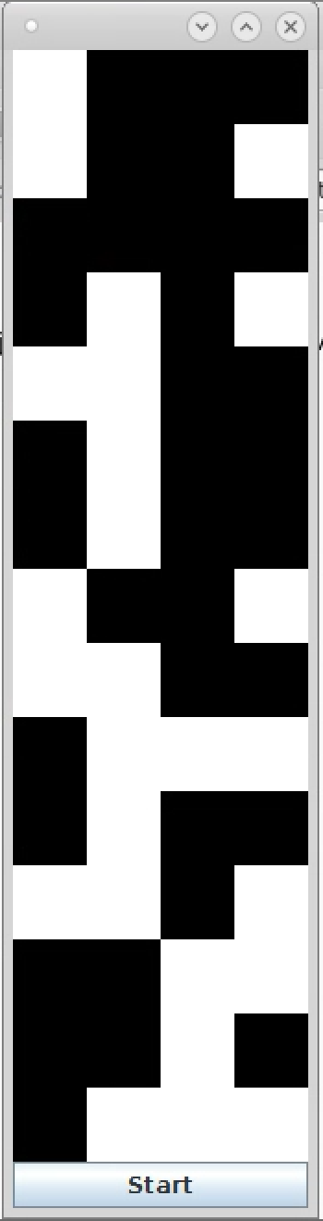
Modified 1D Cellular Automata
A four cell wide 1D Cellular Automata will be implemented
As the program continues, the piece simply generates from the bottom up, making a visual representation of the score using the automata
Color values will also be used to represent octave in which the note takes place, splitting at C

Slide 15
Divergence from Key
Another feature to be implemented is the divergence from the key signature value
Value of key signature is ‘Do’
The classifier determines how often the piece returns to ‘Do’
Value of state represents how long it has been since ‘Do’ has been played
Depending on frequency derived from classifier

Slide 16
Future Works
Multi-track system using harmonic interval probability (would also contribute to the classifier)
Rhythmic additions, including use of rest character
Audio implementation, and multi-key signature work

